Slide 1

CAR PRICE PREDICTION
Submitted by:
Akas Mandal

Slide 2
ACKNOWLEDGMENT
With the covid 19 impact, we have seen lot of changes in the Automobile market. Now some cars are in demand hence making them costlier and some are not in demand hence it is cheaper. One of our clients who works with small traders, sells used cars. With the change in market due to covid 19 impact, our client is facing problems with their previous car price evaluation machine learning models. So, they are looking for new machine learning models from new data.
Based on the business requirements of the Client, I have scraped the Data from the well-known e-commerce websites such as cars 24, OLX and cardekho.com. Based on the Data collected, we will be predicting the prices of used cars. We will be building various Machine Learning models. In the end, we will see how all the machine learning models performs. And based on which we will sort the best machine learning model and hyperparameter tune the same to get the improved performance.

Slide 3
INTRODUCTION
Business Problem Framing.
Impact of COVID-19 on Indian automotive sector
The Indian automotive sector was already struggling in FY20. before the Covid-19 crisis. It saw an overall degrowth of nearly 18 per cent. This situation was worsened by the onset of the Covid-19 pandemic and the ongoing lockdowns across India and the rest of the world. These two years (FY20 and FY21) are challenging times for the Indian automotive sector on account of slow economic growth, negative consumer sentiment, BS-VI transition, changes to the axle load norms, liquidity crunch, low-capacity utilisation and potential bankruptcies.
The return of daily life and manufacturing activity to near normalcy in China and South Korea, along with extended lockdown in India, gives hope for a U-shaped economic recovery. Our analysis indicates that the Indian automotive sector will start to see recovery in the third quarter of FY21. We expect the industry demand to be down 15-25 % in FY21. With such degrowth, OEMs, dealers and suppliers with strong cash reserves and better access to capital will be better positioned to sail through.

Slide 4
Auto sector has been under pressure due to a mix of demand and supply factors. However, there are also some positive outcomes, which we shall look at.
With India’s GDP growth rate for FY21 being downgraded from 5% to 0% and later to (-5%), the auto sector will take a hit. Auto demand is highly sensitive to job creation and income levels and both have been impacted. CII has estimated the revenue impact at $2 billion on a monthly basis across the auto industry in India.
Supply chain could be the worst affected. Even as China recovers, supply chain disruptions are likely to last for some more time. The problems on the Indo-China border at Ladakh are not helping matters. Domestic suppliers are chipping in but they will face an inventory surplus as demand remains tepid.
The Unlock 1.0 will coincide with the implementation of the BS-VI norms and that would mean heavier discounts to dealers and also to customers. Even as auto companies are managing costs, the impact of discounts on profitability is going to be fairly steep.

Slide 5
The real pain could be on the dealer end with most of them struggling with excess inventory and lack of funding options in the post COVID-19 scenario. The BS-VI price increases are also likely to hit auto demand.
There are two positive developments emanating from COVID-19. The China supply chain shock is forcing major investments in the “Make in India” initiative. The COVID-19 crisis has exposed chinks in the automobile business model and it could catalyse a big move towards electric vehicles (EVs). That could be the big positive for auto sector.

Slide 6
Conceptual Background of the Domain Problem
Understanding the above business problem, there are certain factors that will influence the automotive industries in the future. Some of them include digital technologies, changing customer preferences, electrical vehicles, intelligent ability, and technical advancements. Technologies such as artificial intelligence, machine learning, cloud computing, and internet of things will also play an important role in developing new business models. Apart from that, they enable customers to ensure a better mobility experience. In other words, technologies may impact automotive industry units significantly that will change the markets. The introduction of electrical cars and hybrid vehicles may transform the automobile industries in coming years.

Slide 7
Review of Literature.
As per the requirement of our client, I have scrubbed data from different used cars selling merchants websites, and so based on the data collected I have tried analysing based on what factors the used car price is decided? What is the relationship between cost of the used cars and other factors like Fuel type, Brand and Model, year the car is purchased and No. Of owners before selling? And so based on all the above consideration I have developed a model that will predict the price of the used cars.

Slide 8
Motivation for the Problem Undertaken
I have taken this problem based on the requirement of the client and also, with a curiosity to know how the used cars markets are at the time of pandemic.

Slide 9
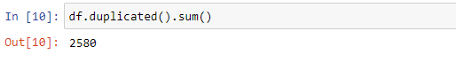
Analytical Problem Framing
Mathematical/ Analytical Modelling of the Problem
On importing the data that is collected I have done some initial play around to understand the data and to cleanse the data.
Data Cleansing.
On data cleansing I have detecting duplicate records in the data collected and the null values in the data.
As like we can see I had 2580 duplicate records out of 7858, I decided to drop all the duplicate records because it will not help us in creating a perfect model.
After dropping the duplicate records, I checked for null values in the data.

Slide 10
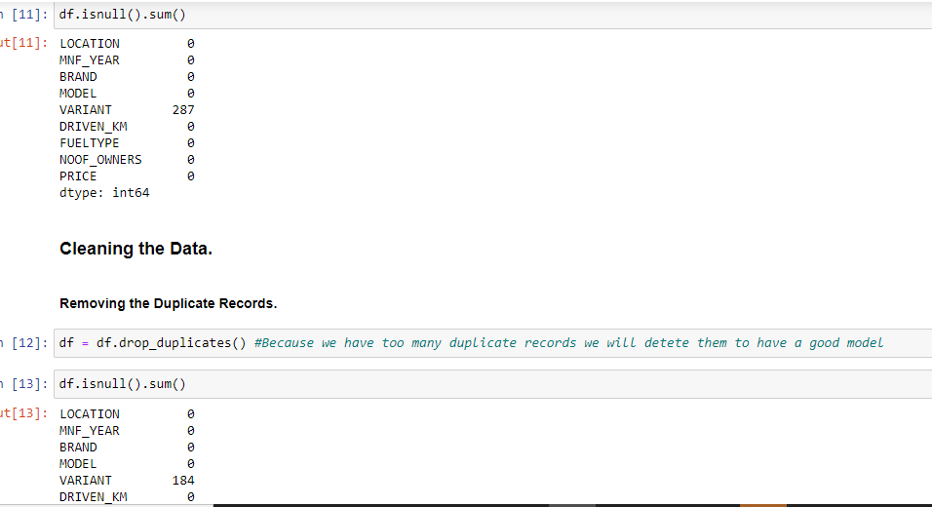
We have 184 null values in Variant column, I have used those null values in the model building but I have changed null values as not mentioned, this will also help the client to predict the values on the used cars without the Variant values.

Slide 11
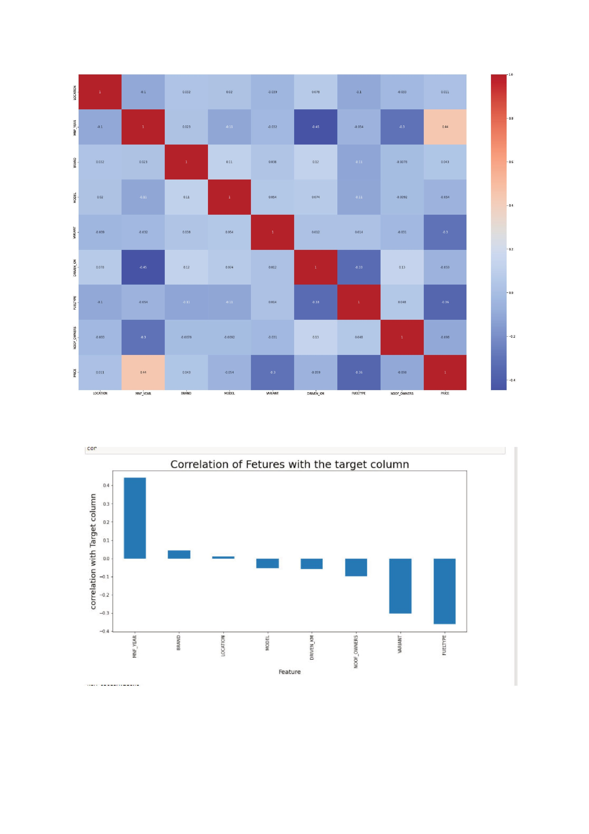

Slide 12
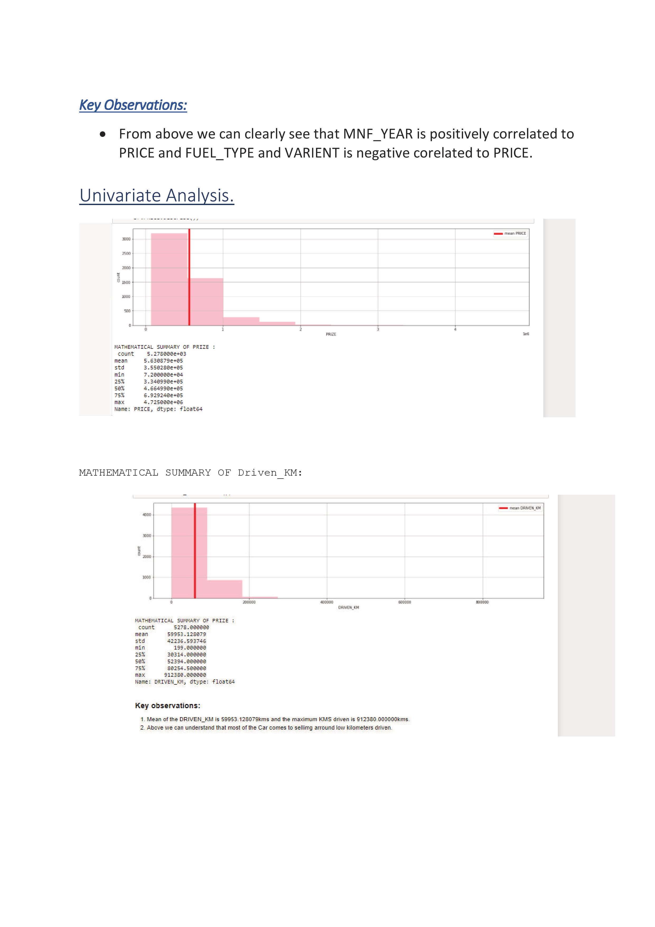

Slide 13
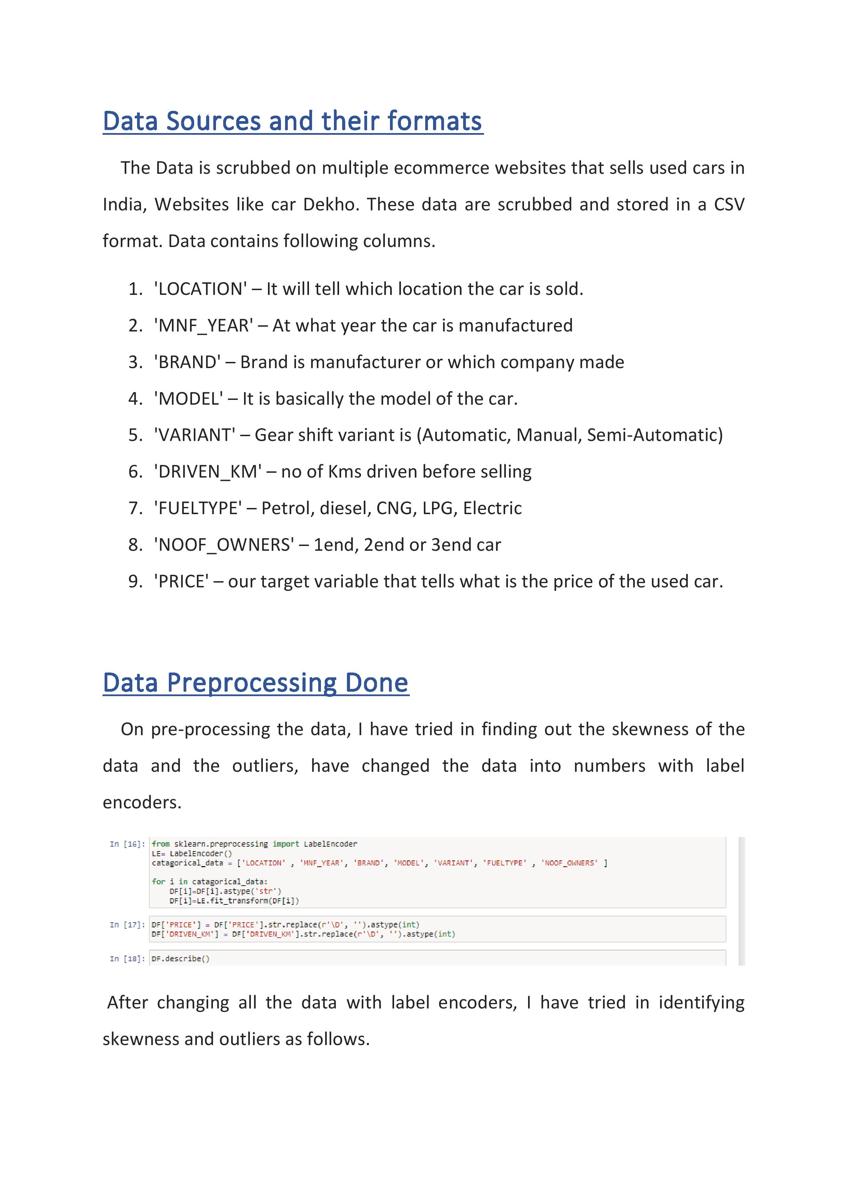

Slide 14
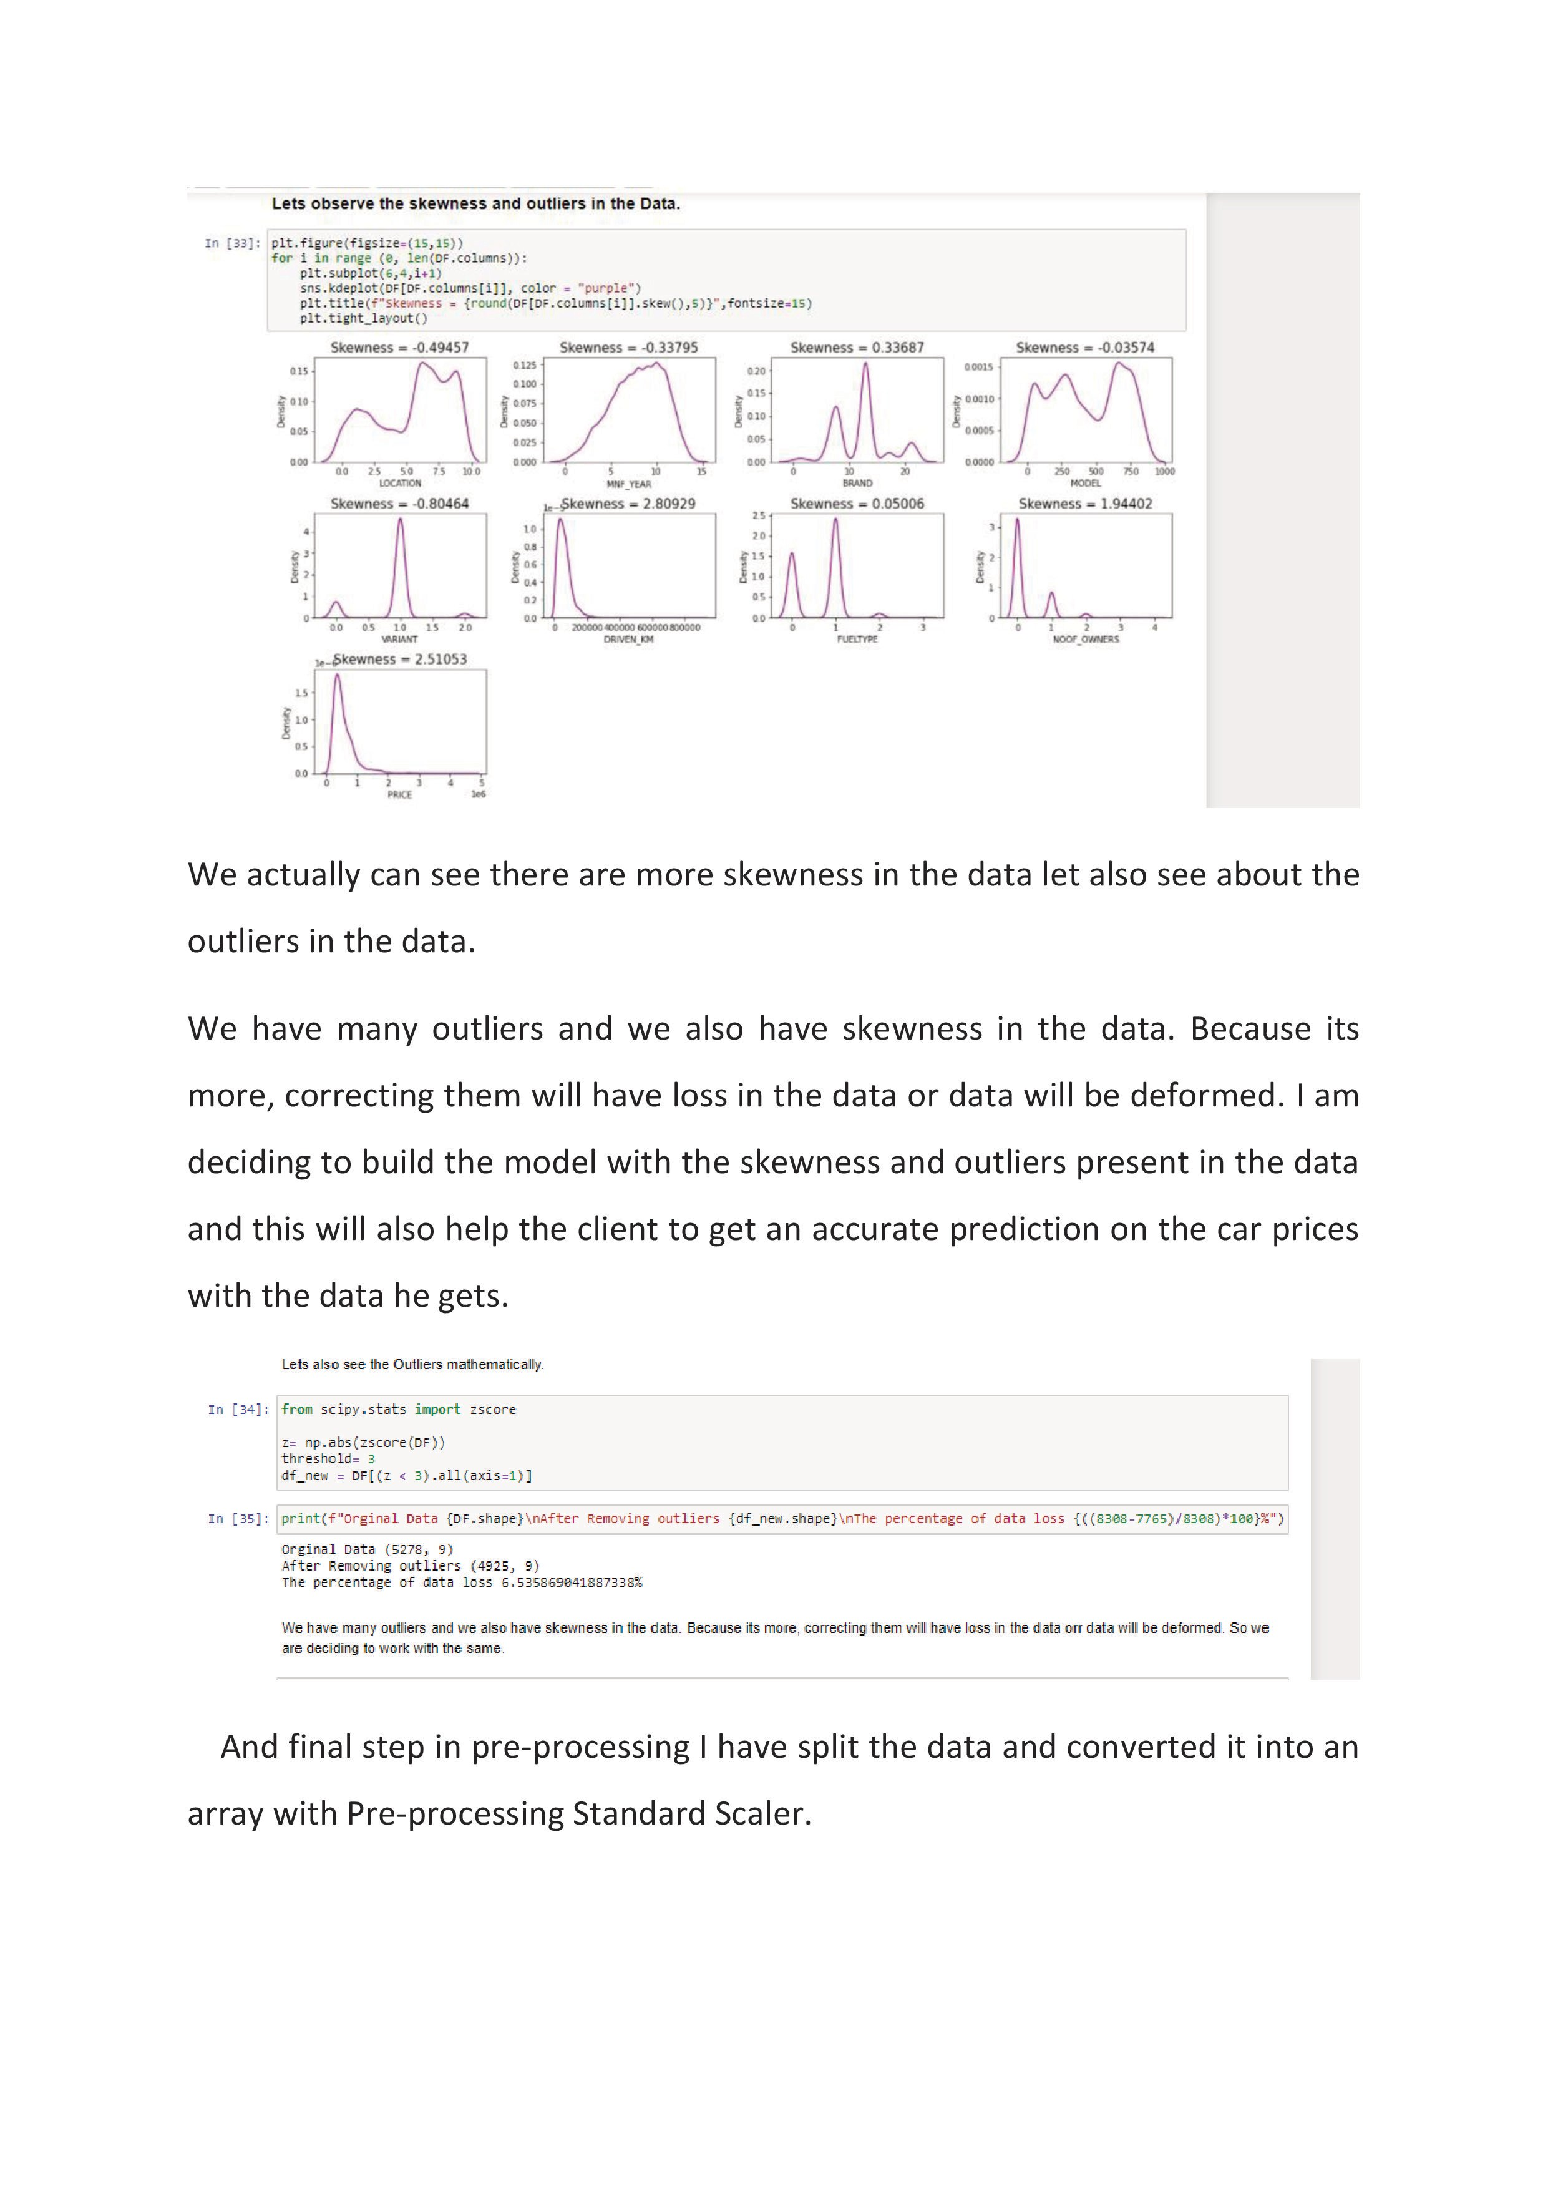

Slide 15
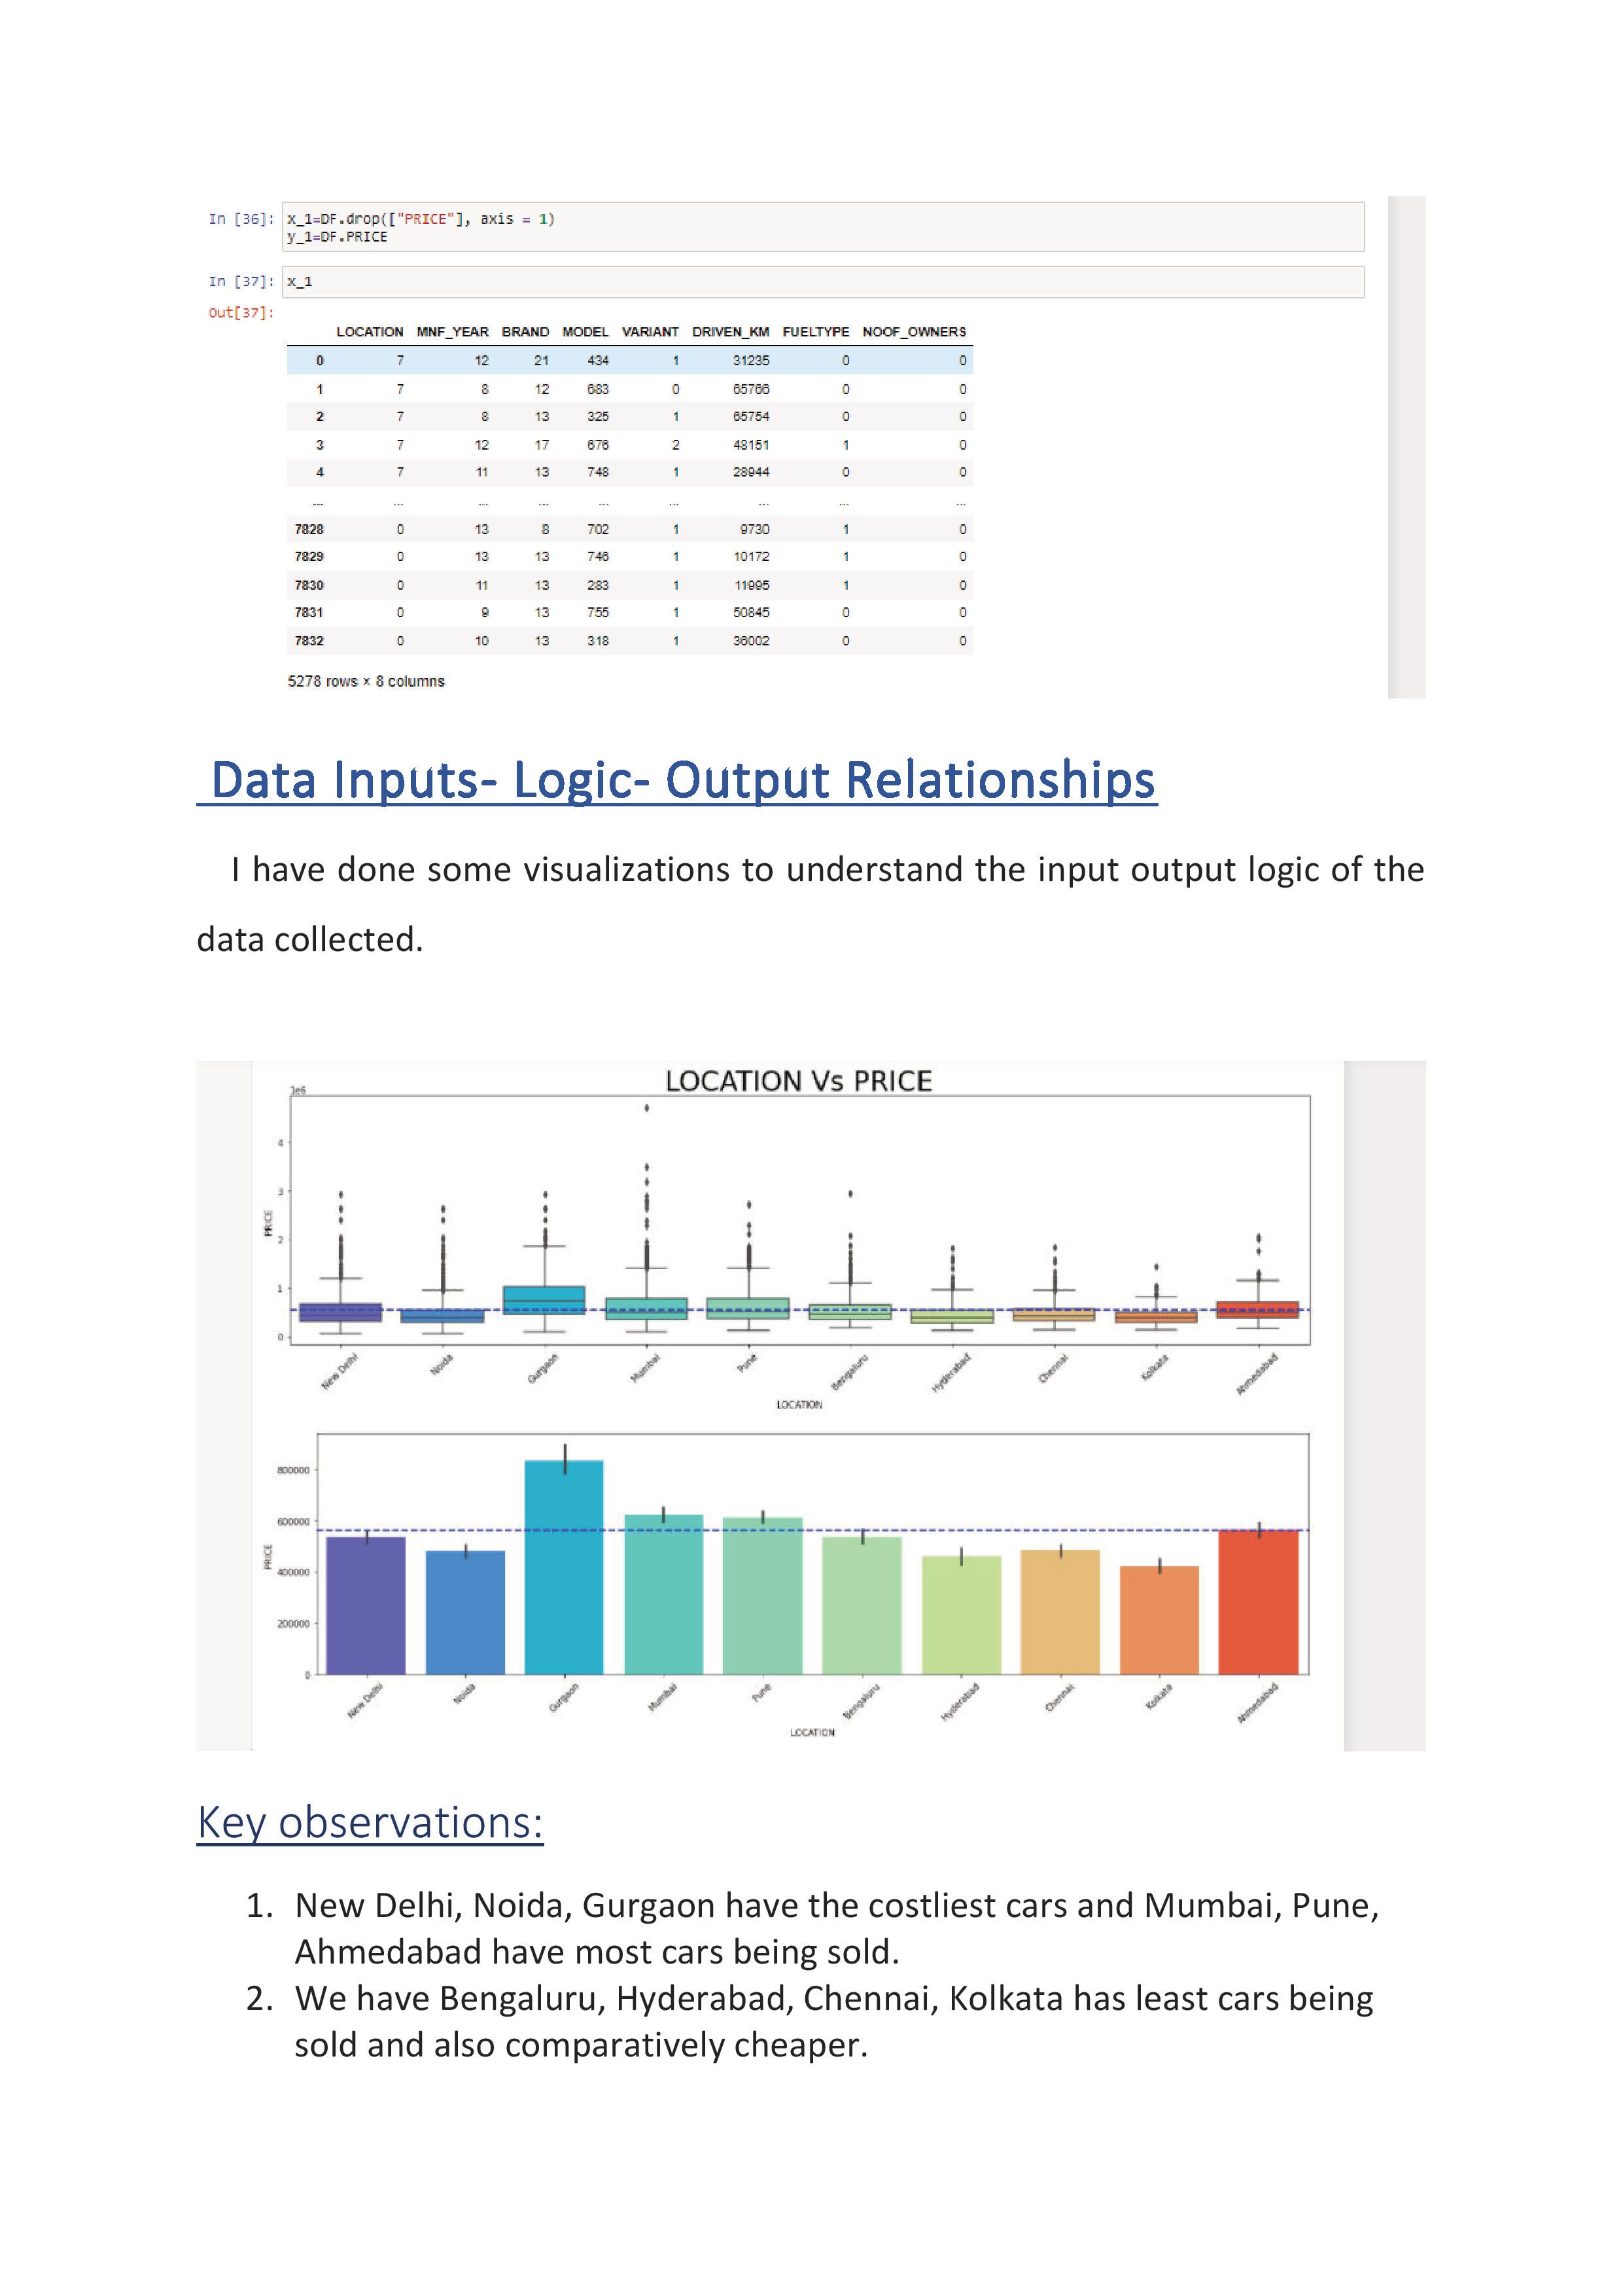

Slide 16
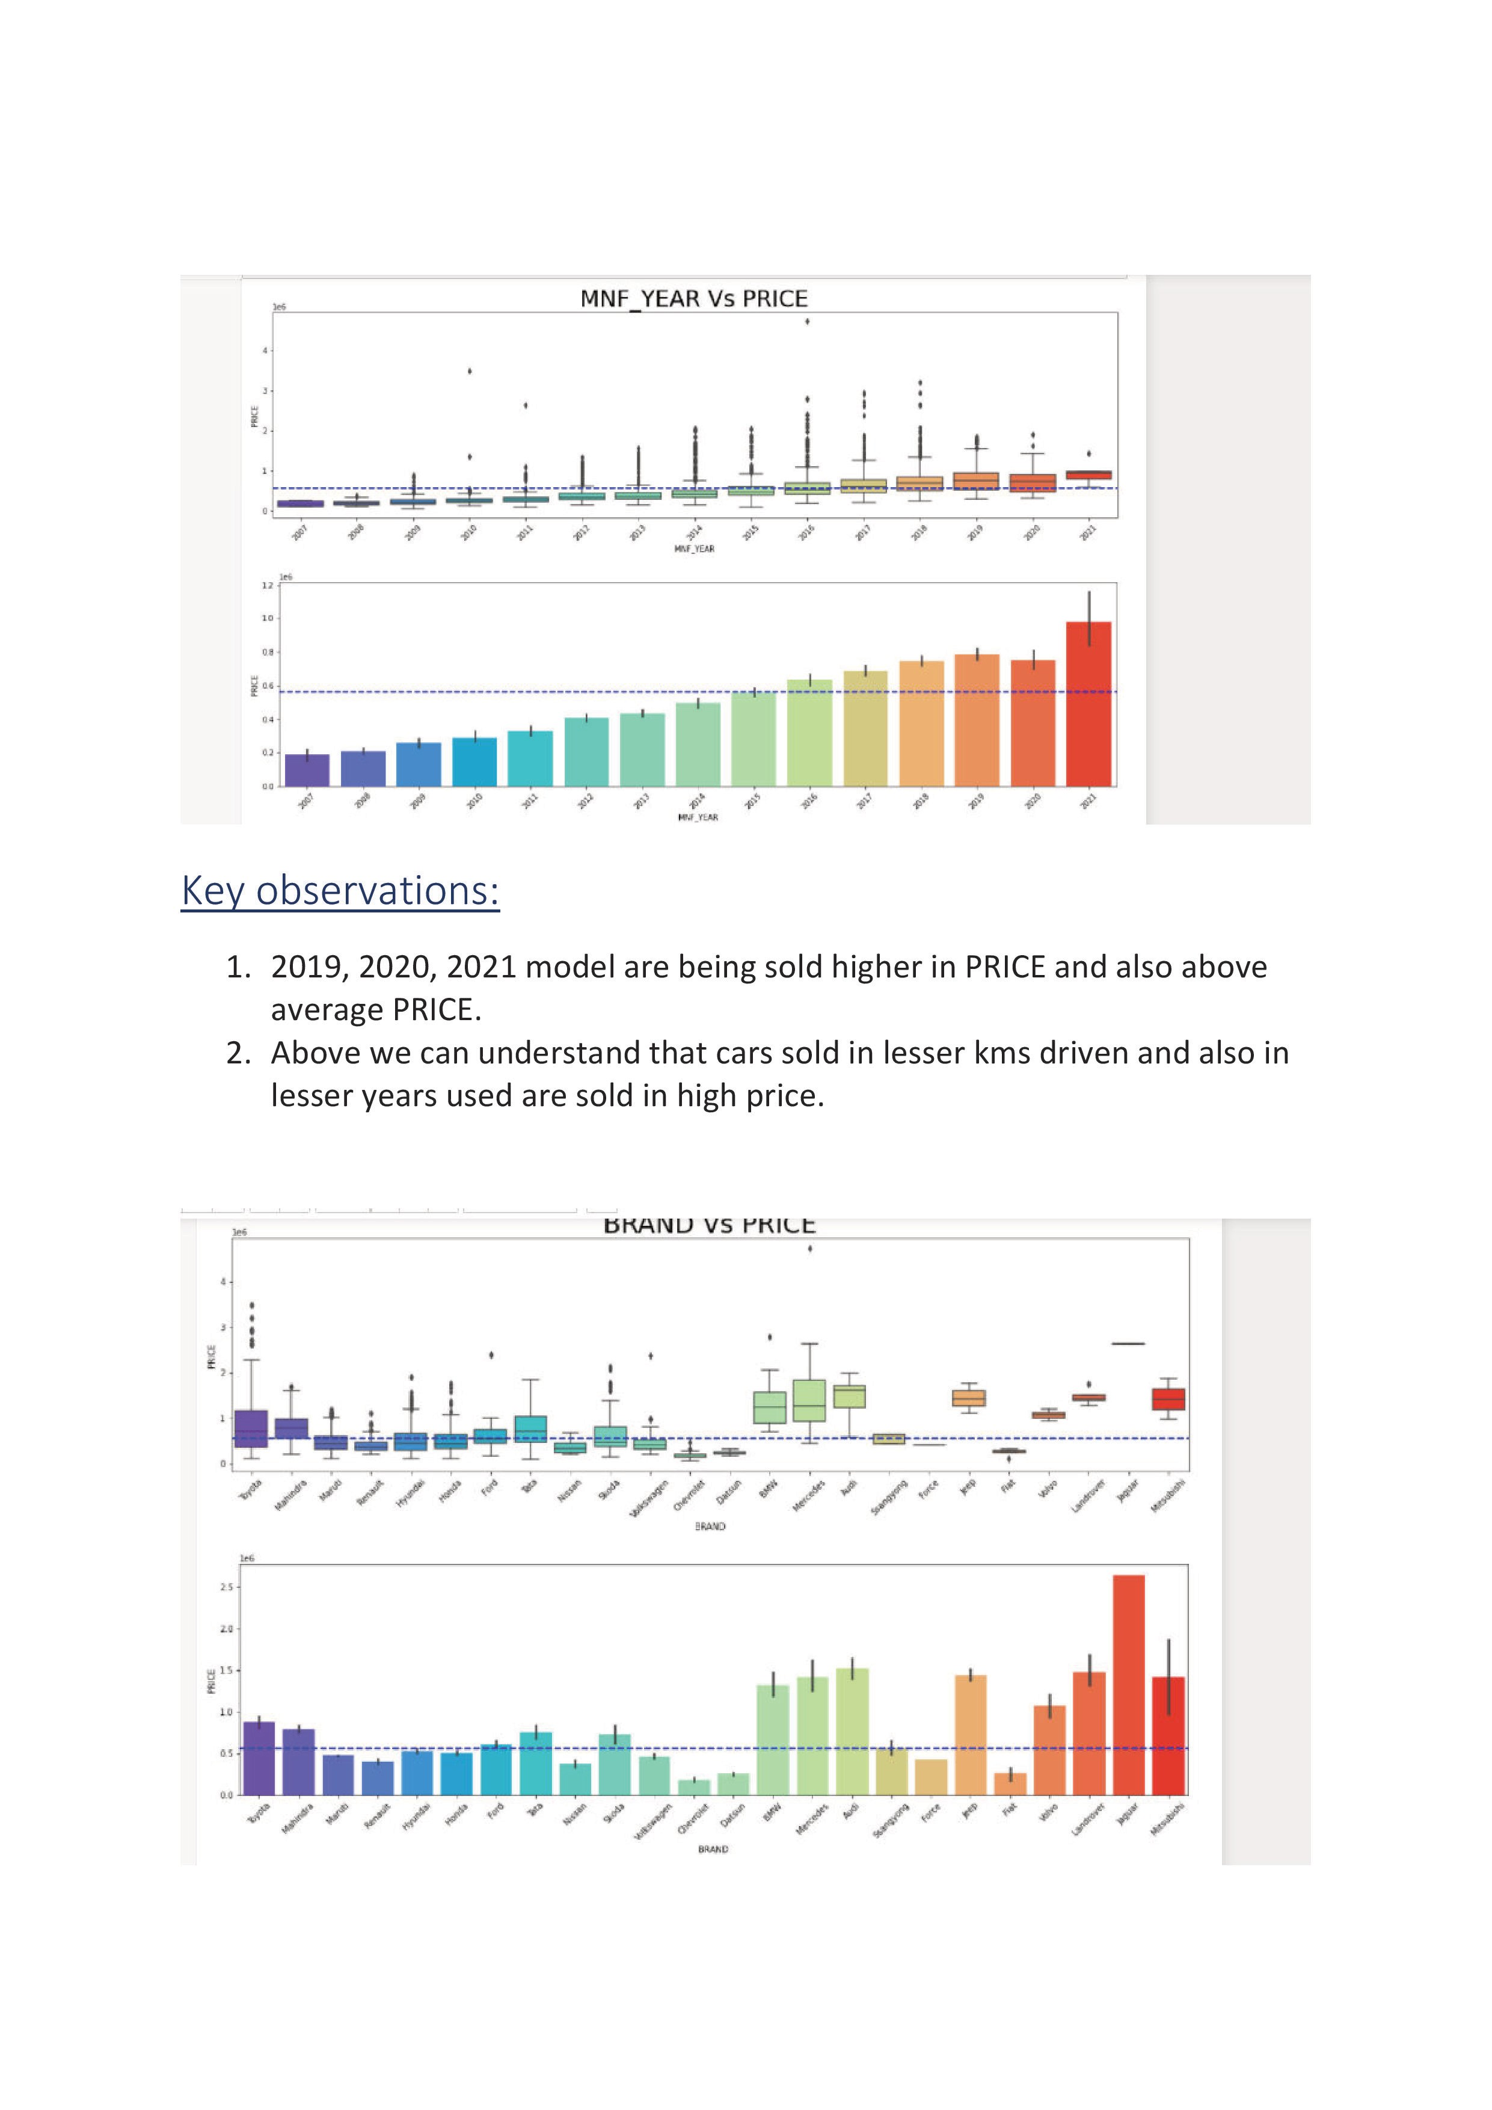

Slide 17
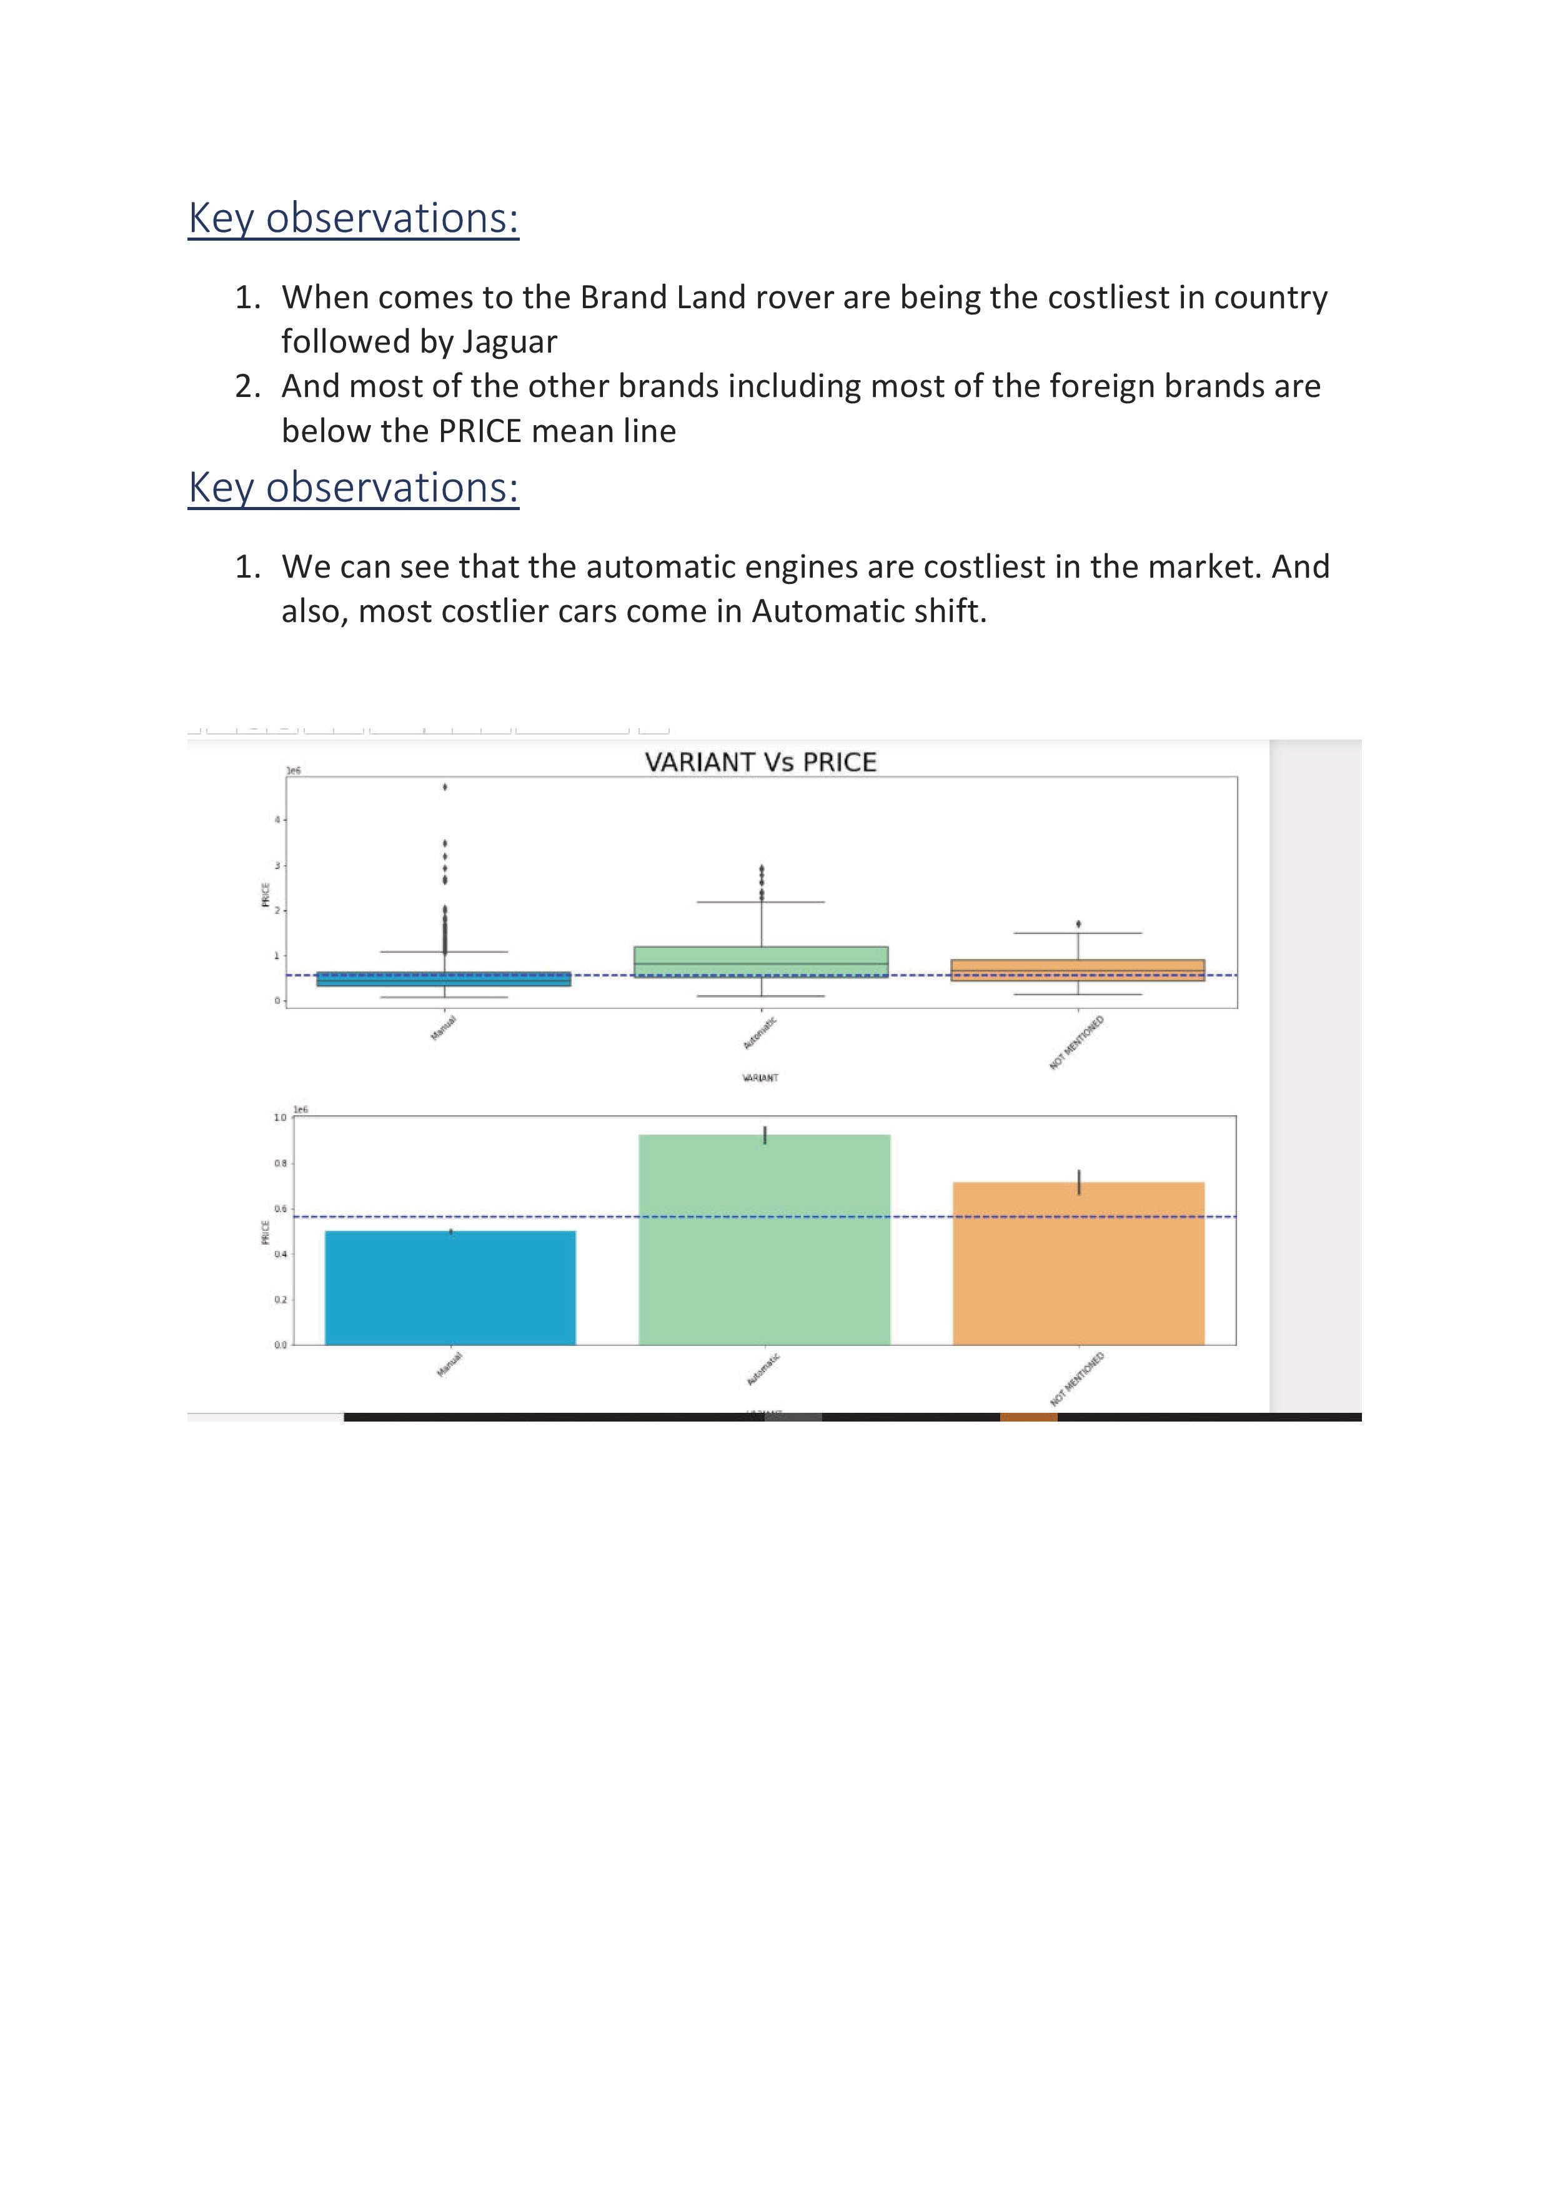

Slide 18
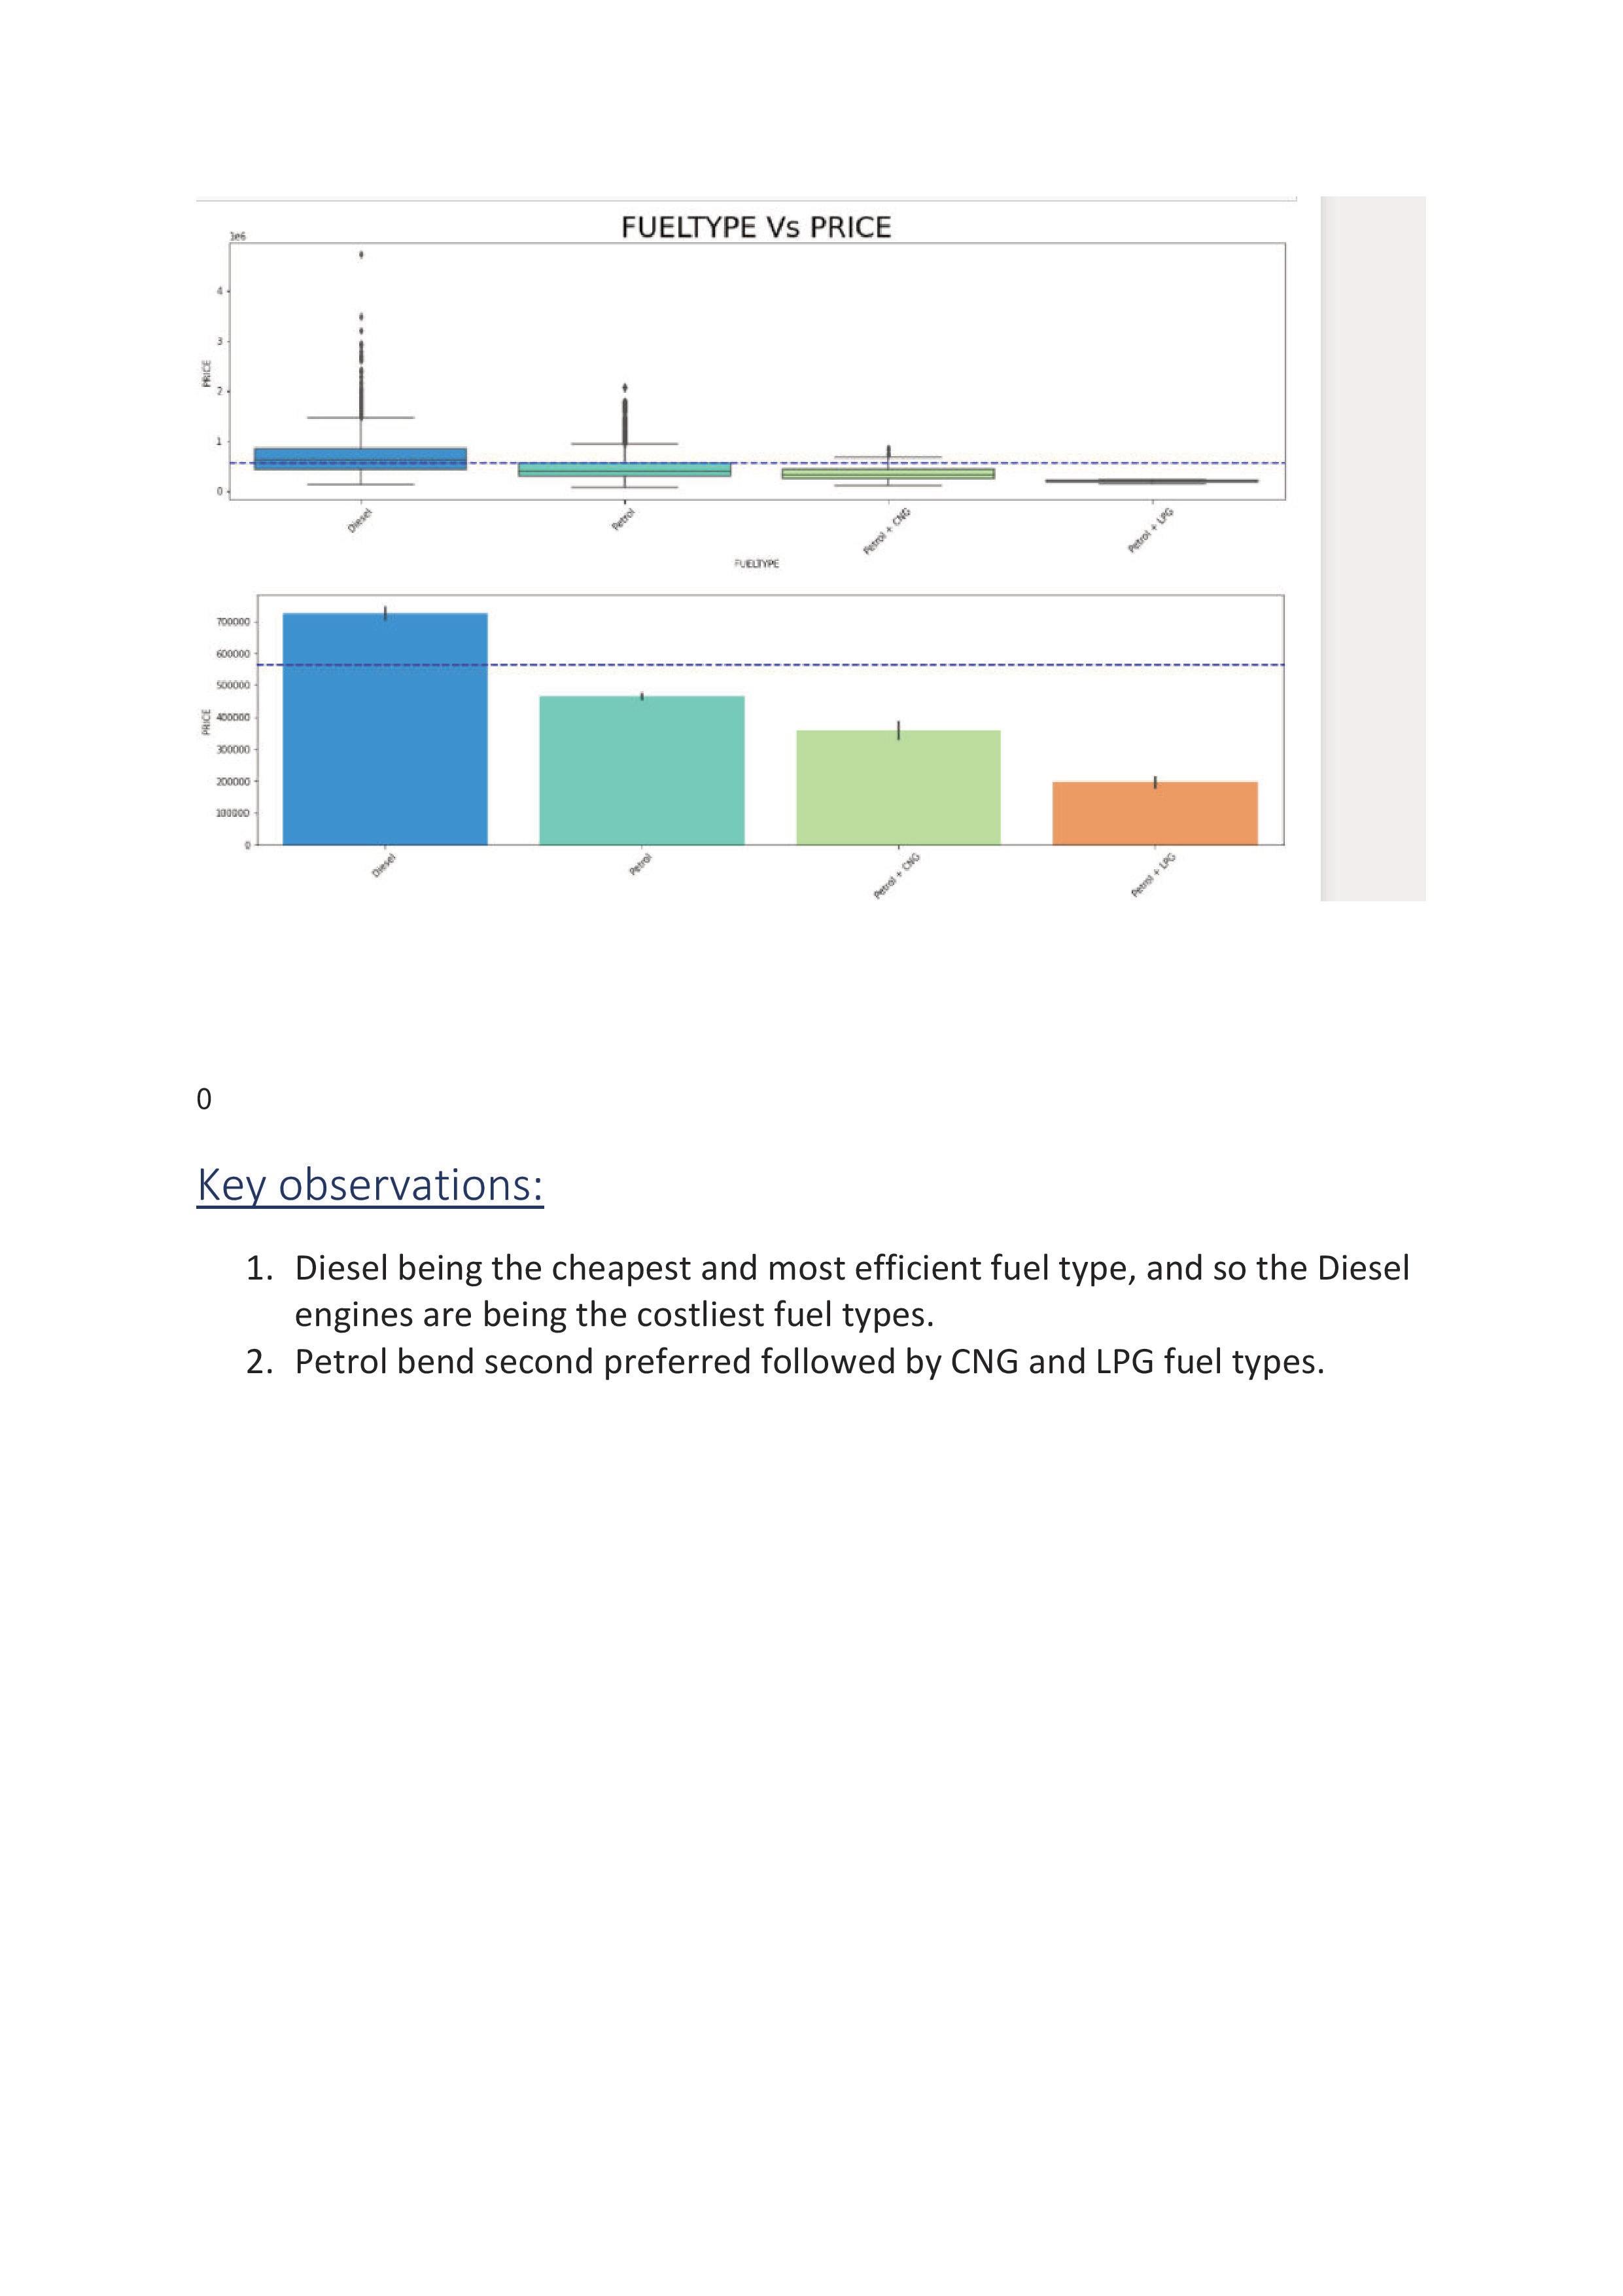

Slide 19
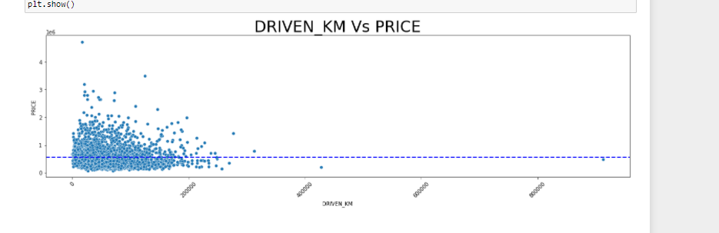
Key Observations:
The lesser kms driven are evidently sold costlier
Hardware and Software Requirements and Tools Used
Python 3.10.4
NumPy.
Pandas.
Matplotlib.
Seaborn.
SciPy
Sklearn.
Anaconda Environment, Jupyter Notebook.

Slide 20
Model/s Development and Evaluation
Identification of possible problem-solving approaches (methods).
Considering the business requirement of the client, I have collected the precise data to predict the used car price but there where multiple data of the car that are available. Data like colour of the car, sun roof attached, music system brand, electronics in the car, tyre brands, seat colours and much more. But after analysing all these data I have selected the data that have more correlation with the price of the car. Data like manufacturing year, number of owners used before, mode, fuel variant, gear shift variant, Brand of the car. I experimented and visualized how these variables contributed more towards the deciding factor of the car price. Based on such visualization I have built the model.

Slide 21
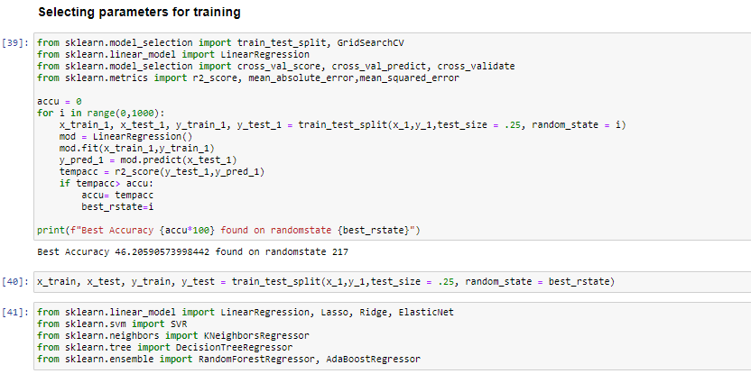
on selecting the best random state parameter, I have used nine regression algorithms to train my model. Based on the best model score and best CV score I have selected Random Forest Regressor as the final model.

Slide 22
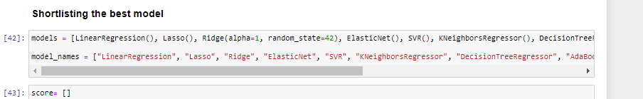
Run and evaluate selected models
I have used nine different regression algorithms to shortlist the best model .
Cross validation mean score and the model score.
As live saw above Random Forest Regression model stands at the top with the model score of 98.10 with the CV score of 83.11 further, I am going to hyperparameter tune the model to reduce over fitting and to increase the performance of the model.

Slide 23
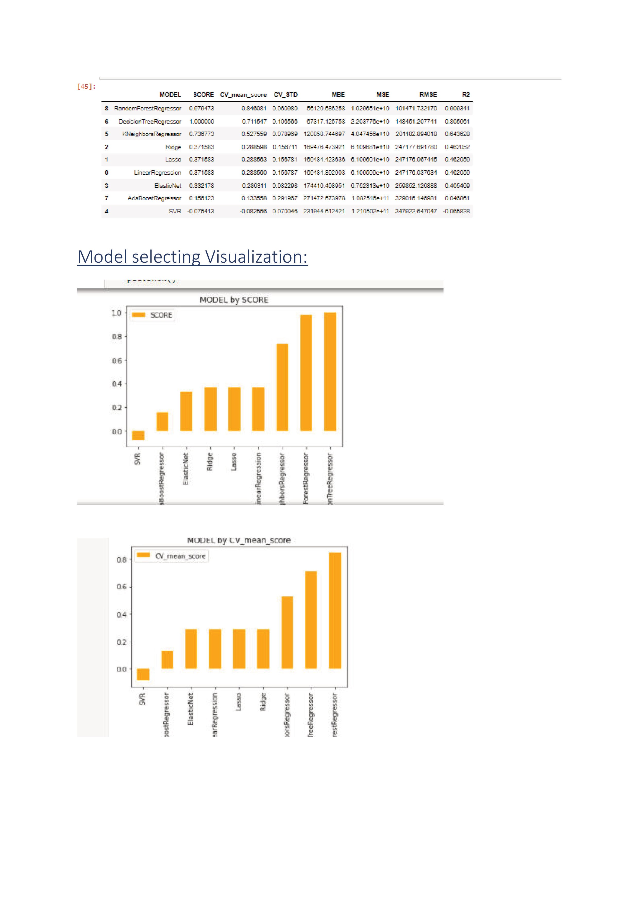

Slide 24
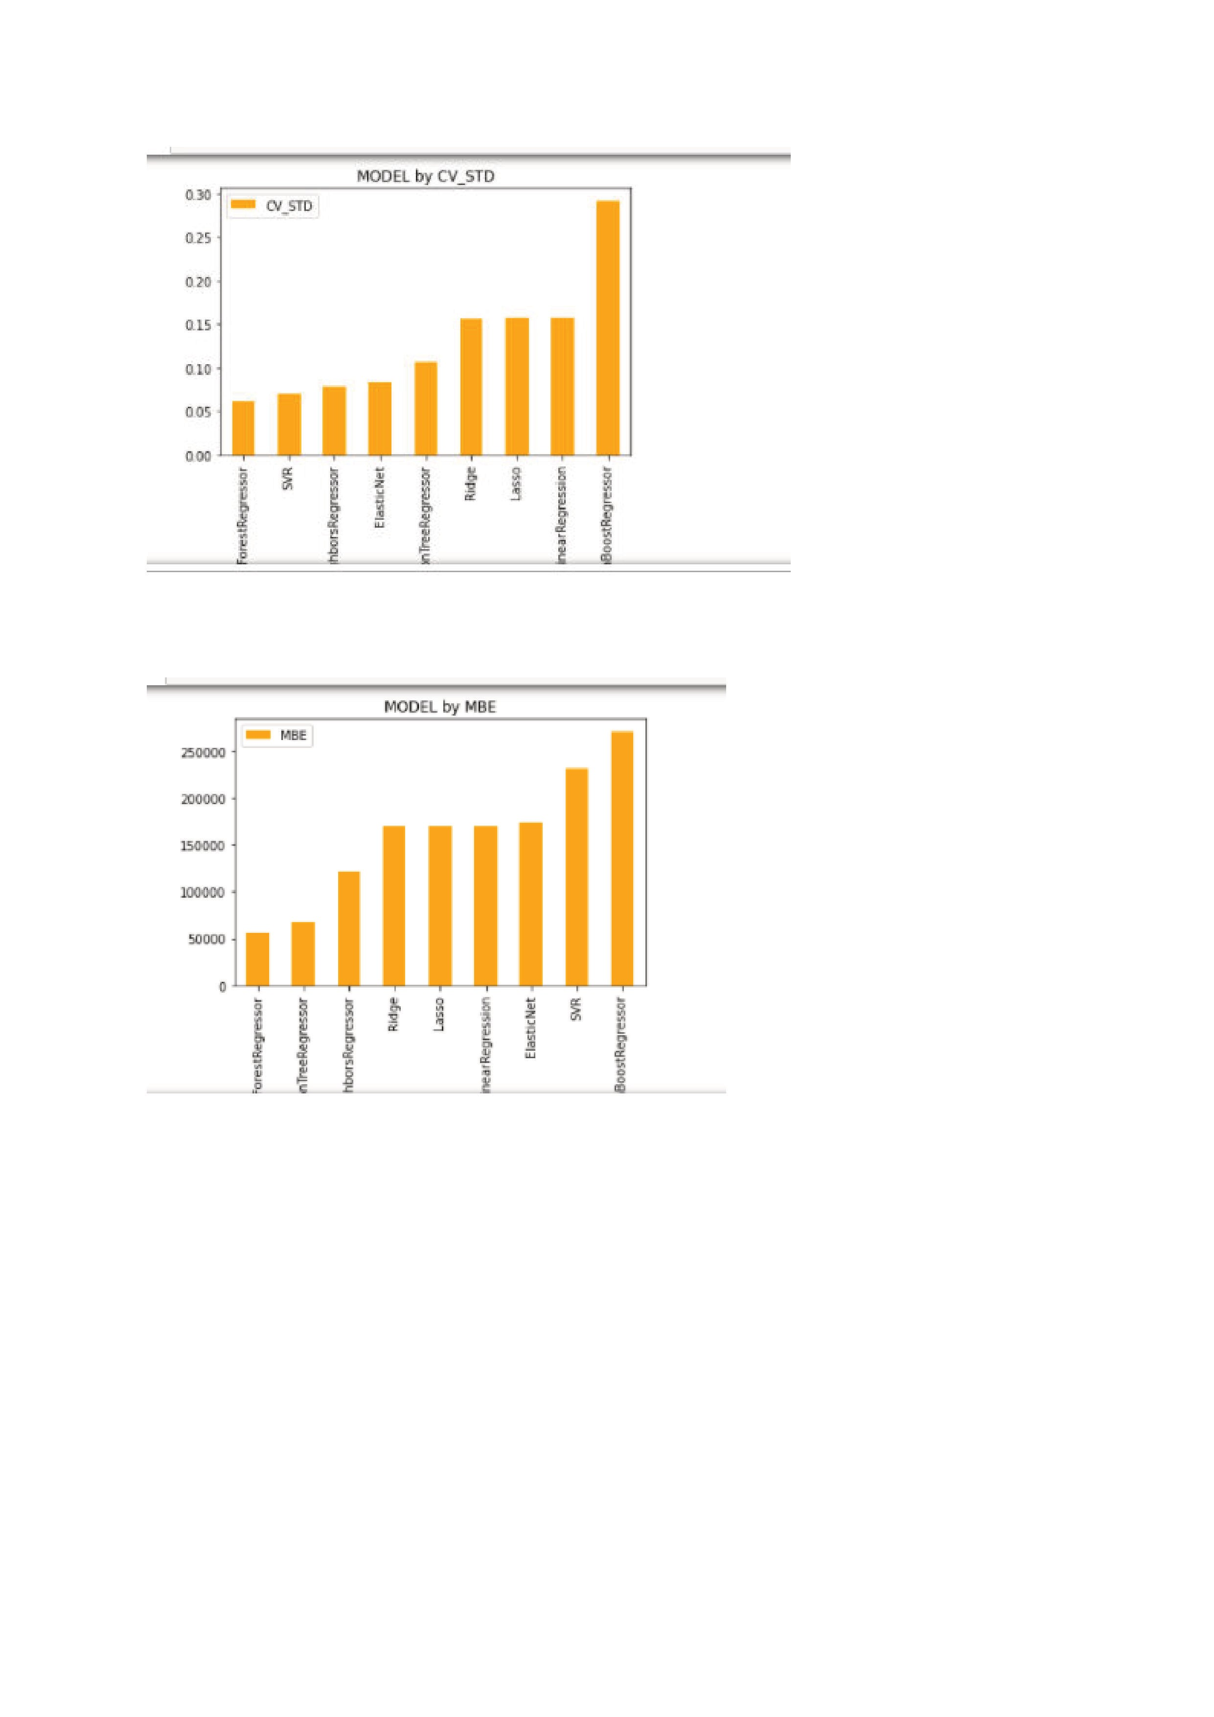

Slide 25
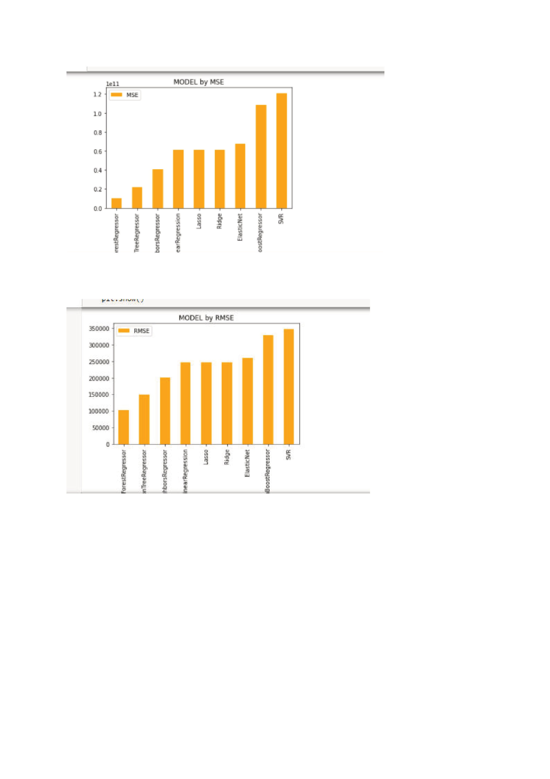

Slide 26
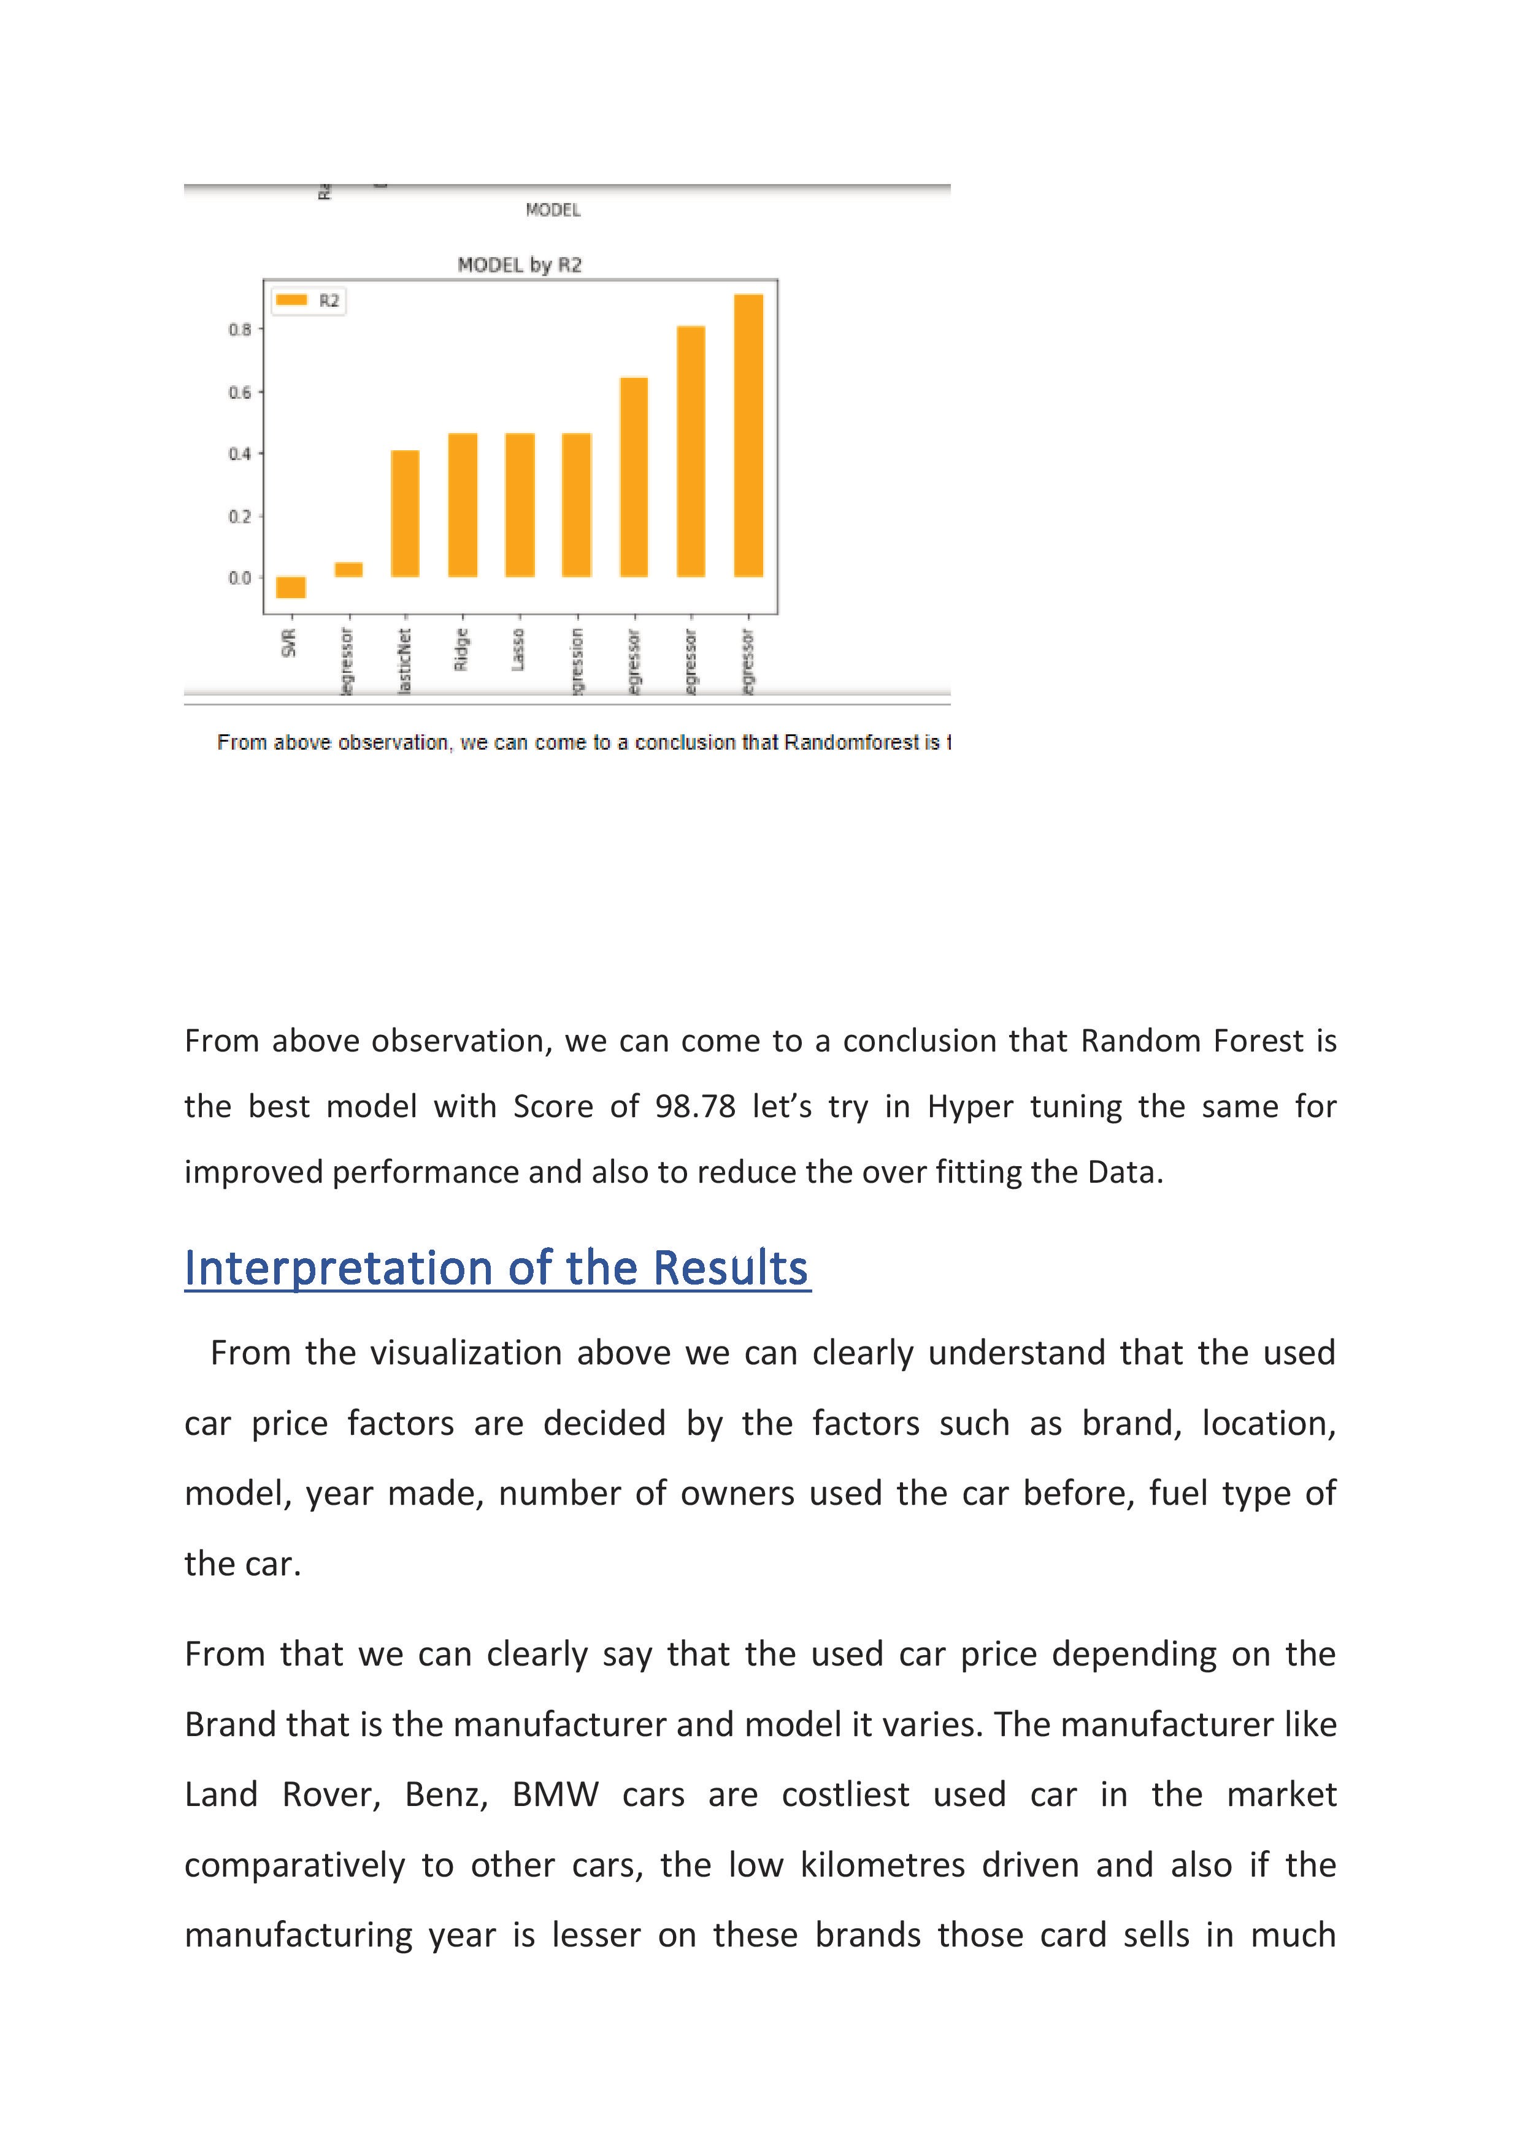

Slide 27
CONCLUSION
Key Findings and Conclusions of the Study
The manufacturer like Land Rover, Benz, BMW cars are costliest used car in the market comparatively to other cars, the low kilometres driven and also if the manufacturing year is lesser on these brands those card sells in much higher rates or closest to the buying new car rates. The Diesel variant and Automatic shift variants are also costliest user car variants in the used car market.
Learning Outcomes of the Study in respect of Data Science
The above research will help our client to study about the latest used car market and with the help of the model built he can easily predict the price ranges of the cars, and also will helps him to understand based on what factors the Car Price is decided.

Slide 28
Limitations of this work and Scope for Future Work
The limitation of the study is that in the volatile changing market we have taken the data, to be more precise we have taken the data at the time of pandemic, so when the pandemic ends the market correction might happen slowly. So based on that again the deciding factors of the used car prize might change and we have shortlisted and taken these data from the important cities across India, if the seller is from the different city our model might fail to predict the accurate prize of that used car.

